Slide 1
Web Crawler And Big Data
Pengyu Li

Slide 2
Contents
What’s Web Crawler
Web Crawler And Big Data
A Popular Web Scraping Framework ------ Scrapy
Reference

Slide 3
What’s Web Crawler ?^{[1]}
Internet bot
Systematically browse World-Wide-Web
Used for search engine optimization (Web Indexing)
Browse website and determine the link destinations in site
Copy all the pages they visit and search engine will index them so
that users could search them more efficiently.
Visit sites as schedule, update information periodically.

Slide 4

Web Crawler and Big Data
Data-Driven World
WWW has Big Data
How many ways you can get Big Data ?^{[2]}
Direct User Input (Number of data is limited, unless you are Big Name like Facebook, Twitter)
Third Party APIs (Twitter, Facebook) (Not all companies are will to share their data)
Server Logs (Same as User Input)
Web Crawling or Scarping (What most data-driven companies do)

Slide 5


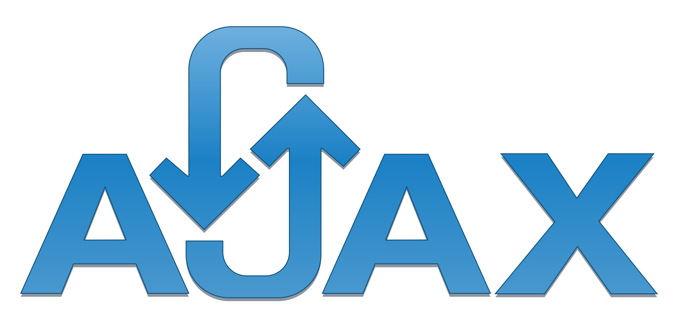
Web Crawler and Big Data
Building a web crawler is not easy !
Scraping and Anti-Scraping
(Sometimes the company don’t want third party’s crawler to access their data)
May cause some potential legal issues
(You should ensure your crawler will not violate term of use in such website. And make sure the data is public accessible.)
You “can’t” grasp data from AJAX
(In other word, you can only resolve the html content from a pre-rendered website)

Slide 6

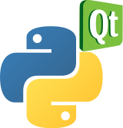
Web Crawler and Big Data
Web Crawler with AJAX Rendered page !
Solution 1: Simulation
Similar as End-to-End testing, simulate real user’s behavior, based on JS
engine.
Tools

Slide 7
Web Crawler and Big Data
Web Crawler with AJAX Rendered page !
Solution 2: Analyze the request and response packages. Find AJAX request and directly request data from certain url.

Slide 8
Web Crawler and Big Data
Web Crawler with AJAX Rendered page !
Solution 2: Analyze the request and response packages. Find AJAX request and directly request data from certain url.

Slide 9
A Popular Framework for Web Crawling
An open source and collaborative framework for extracting the data you need from websites.
In a fast, simple, yet extensible way.
Installation
pip install scrapy
Creating a project
scrapy startproject yourprojectsname

Slide 10
A Popular Framework for Web Crawling
An open source and collaborative framework for extracting the data you need from websites.
In a fast, simple, yet extensible way.
Parse HTML/XML^{[3]}
Use Selector to choose DOM with data you want to extract
response.css() response.xpath()
Define Item
for quote in response.css(“xxx”):
yield{
‘text’: quote.css(“yyy”).extract()
‘author’: quote.css(“zzz”).extract()
}

Slide 11
A Popular Framework for Web Crawling
An open source and collaborative framework for extracting the data you need from websites.
In a fast, simple, yet extensible way.
Store extracted data
scrapy crawl quotes -o quotes.json
It will generate a json file which contains data you scraped.
Build your data pipeline
Configure your action in pipelines.py
cleansing HTML data
validating scraped data (checking that the items contain certain fields)
checking for duplicates (and dropping them)
storing the scraped item in a database

Slide 12
A Popular Framework for Web Crawling
An open source and collaborative framework for extracting the data you need from websites.
In a fast, simple, yet extensible way.
Deploy your project on cloud
Scrapy Cloud, Scraping Hub …

Slide 13
Reference
[1] https://en.wikipedia.org/wiki/Web_scraping
[2] https://www.grepsr.com/importance-of-web-crawling-in-the-age-of-big-data-2/
[3]
https://doc.scrapy.org/

